Slide 1
Pulsed Field Ablation vs. Radiofrequency Ablation in patients with Ventricular arrhythmia
Sung Il Im
Kosin University Gospel Hospital
Kosin University College of Medicine

Slide 2
Introduction
Catheter-based radiofrequency ablation (RFA) has been shown to be an effective strategy for management of refractory ventricular arrhythmias.
However, lesions produced by using standard RFA techniques can be limited in depth
Challenging efficacy of ablation!!
when the region of interest is contained deep within
myocardium.
Circ Arrhythm Electrophysiol. 2022;15:e011209

Slide 3
Introduction
Arrhythmias involved can range from
- Isolated premature ventricular complexes (PVCs)
- Scar-based, reentrant ventricular tachycardia (VT)
a/w structural heart disease &heart failure
Repeated ablation procedures may be needed to achieve successful control, particularly among those with nonischemic cardiomyopathy (NICM)
- Sites : interventricular septum, LV summit, non-septal
midmyocardial sites, and papillary muscles,
Circ Arrhythm Electrophysiol. 2022;15:e011209

Slide 4
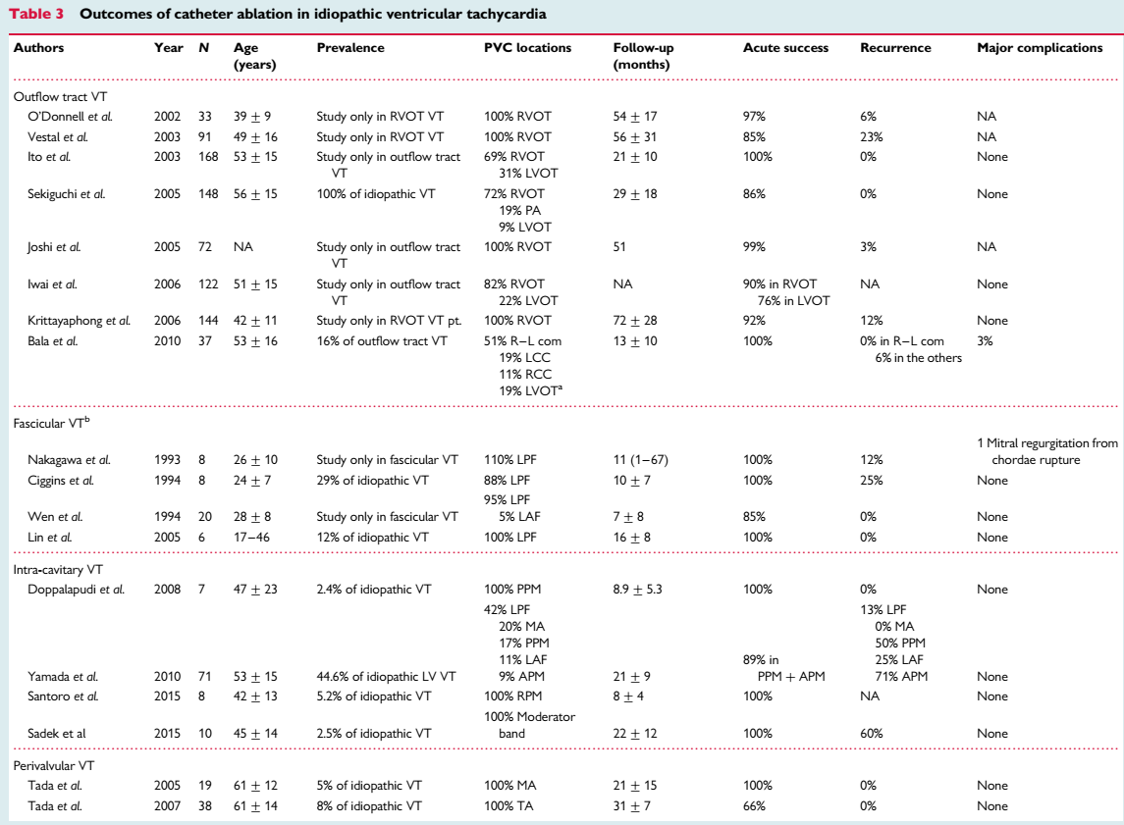
European Heart Journal (2016) 37, 594–609

Slide 5
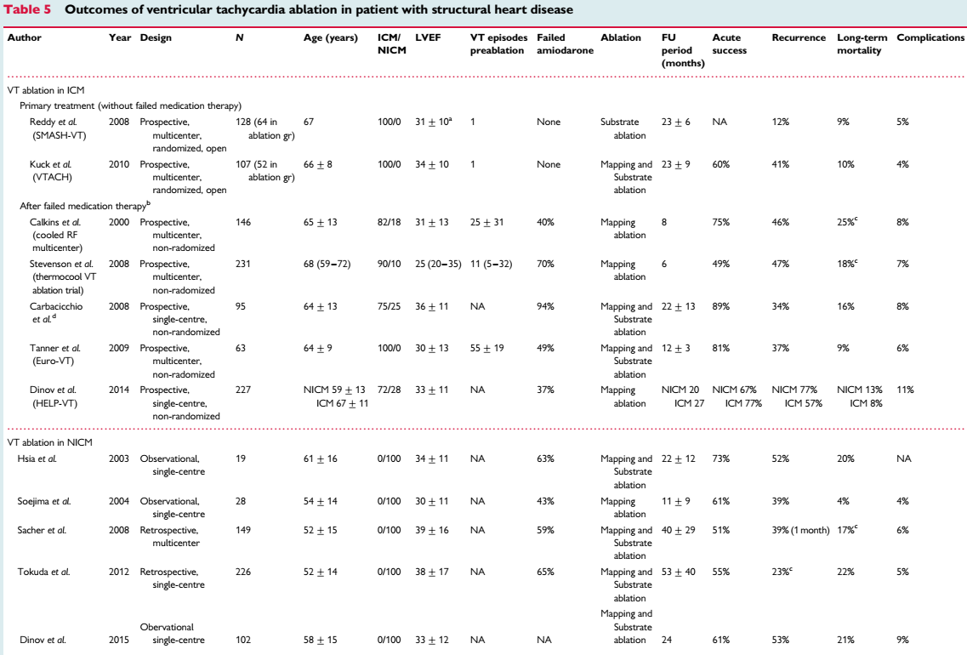

Slide 6
Introduction
Alternative techniques that have been clinically used to create deeper lesions
prolonged, high-power RFA, coronary arterial or venous ethanol injection, RFA via a needle catheter, bipolar ablation, and use of external-beam radiation therapy.
However, these techniques require special expertise and equipment that are not widely available, and their feasibility and efficacy may be limited.
Circ Arrhythm Electrophysiol. 2022;15:e011209

Slide 7
Introduction
Ablation using half-normal saline (HNS) produced larger ex-vivo and in-vivo lesions than normal saline (NS) for the same delivered power.
5% dextrose in water lesions were significantly larger than both HNS and NS lesions.
JACC Clin Electrophysiol. 2018 Sep;4(9):1176-1185.
Circ Arrhythm Electrophysiol. 2022;15:e011209

Slide 8
Introduction
Proposed mechanism
: Relative to NS, the lower charge density of HNS and 5% dextrose in water.
→ Impedance ↑ surrounding the ablating electrode
dissipation of radiofrequency (RF) energy ↓ into the irrigant.
allows for more effective RF current delivery to myocardial tissue.
JACC Clin Electrophysiol. 2018 Sep;4(9):1176-1185.
Circ Arrhythm Electrophysiol. 2022;15:e011209

Slide 9
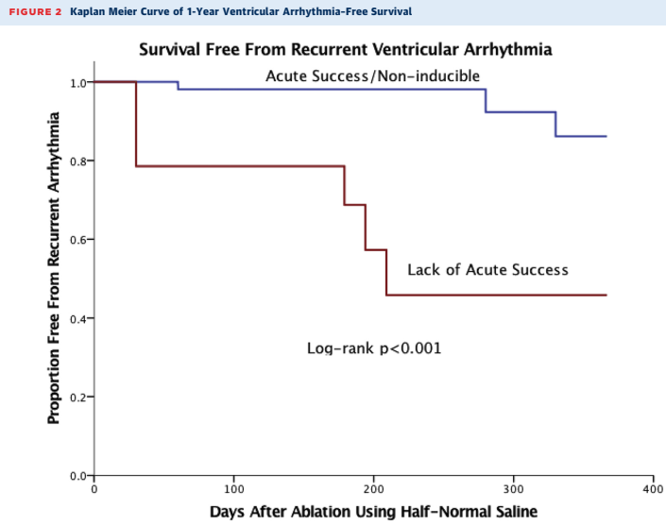
Conclusions The use of HNS to cool an electrode delivering high-power RF current resulted in acute suppression of targeted ventricular arrhythmias in patients in whom standard approaches with NS had failed. These results support prior preclinical studies evaluating the efficacy of this ablation strategy and now show the safety of this approach in clinical cases requiring deeper or more durable lesions.
JACC Clin Electrophysiol. 2018 Sep;4(9):1176-1185.

Slide 10
Conclusion Radiofrequency lesions depth and width correlated with CF, AI, and impedance drop in NVM and IVM but not in LVM. The ncMRI may be useful to assess RF lesion depth and width in NVM, IVM, and LVM
Europace (2019) 21, 1919–1927

Slide 11
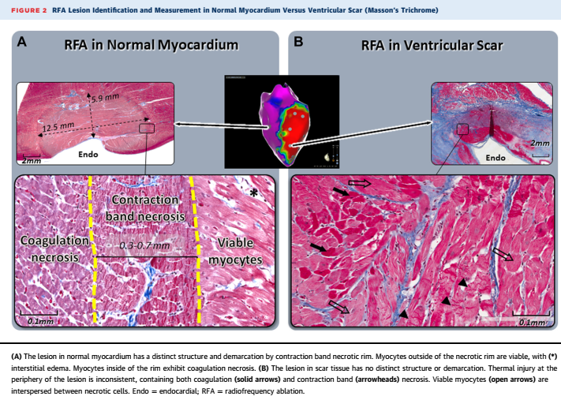
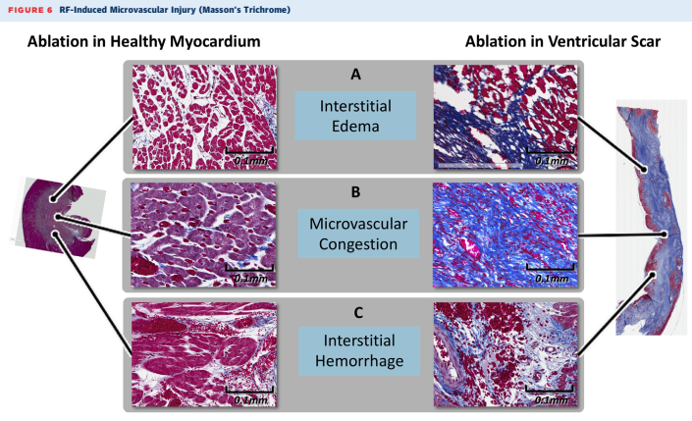
Conclusion: RFA in scarred myocardium results in irregular tissue injury and unpredictable effect on surviving cardiomyocytes. This may be related to biophysical differences between healthy and scarred myocardium
JACC Clin Electrophysiol. 2019 Aug;5(8):920-931

Slide 12
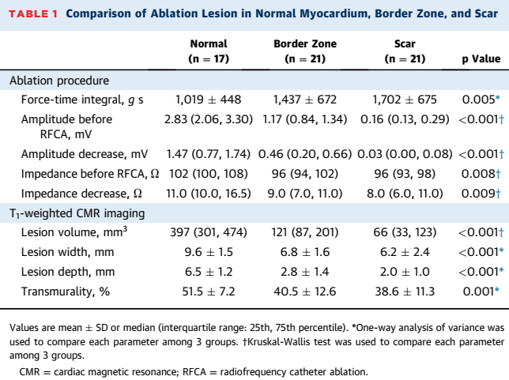
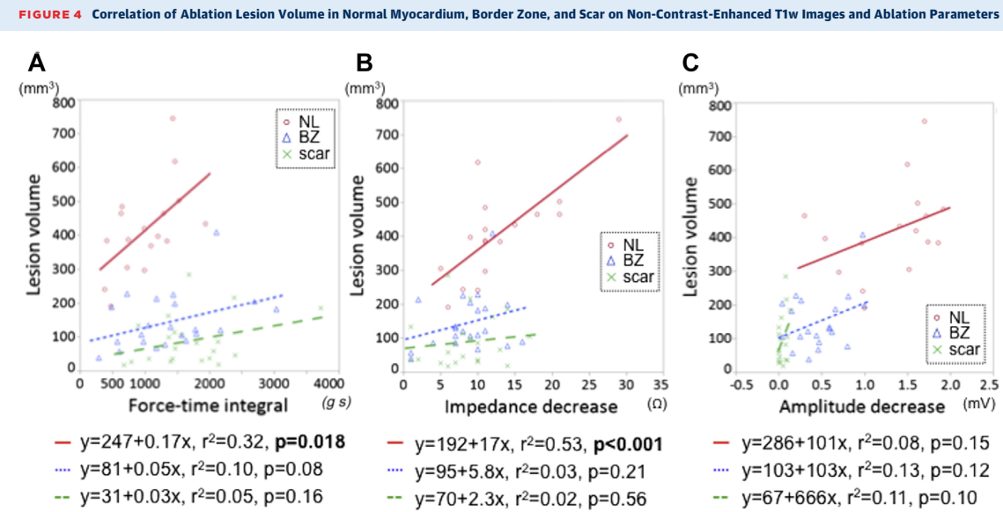
Conclusions T1w CMR can selectively enhance necrotic tissue in and around scar and may allow determination of the completeness of ablation intra- and post-procedure. Lesion formation in scar is affected by tissue characteristics, with fibrosis and fat acting as thermal insulators.
J Am Coll Cardiol EP 2019;5:91–100

Slide 13
Pulsed Field Ablation (PFA)
Pulsed field ablation (PFA) leads to cell death by irreversible electroporation.
Myocardial cells have a greater sensitivity to PFA compared with nerves, arteries, and other collateral structures, making it an attractive energy modality for catheter ablation.
Prior reports have demonstrated safety and efficacy for atrial ablation and have assessed feasibility of ablation in regions of myocardial scar.
Europace. 2019 Dec;22(3):434-439.
Circ Arrhythm Electrophysiol. 2019 Dec;12(12):e007781.
J Am Coll Cardiol. 2019 Jul 23;74(3):315-326.
J Am Coll Cardiol. 2020 Sep 1;76(9):1068-1080.

Slide 14
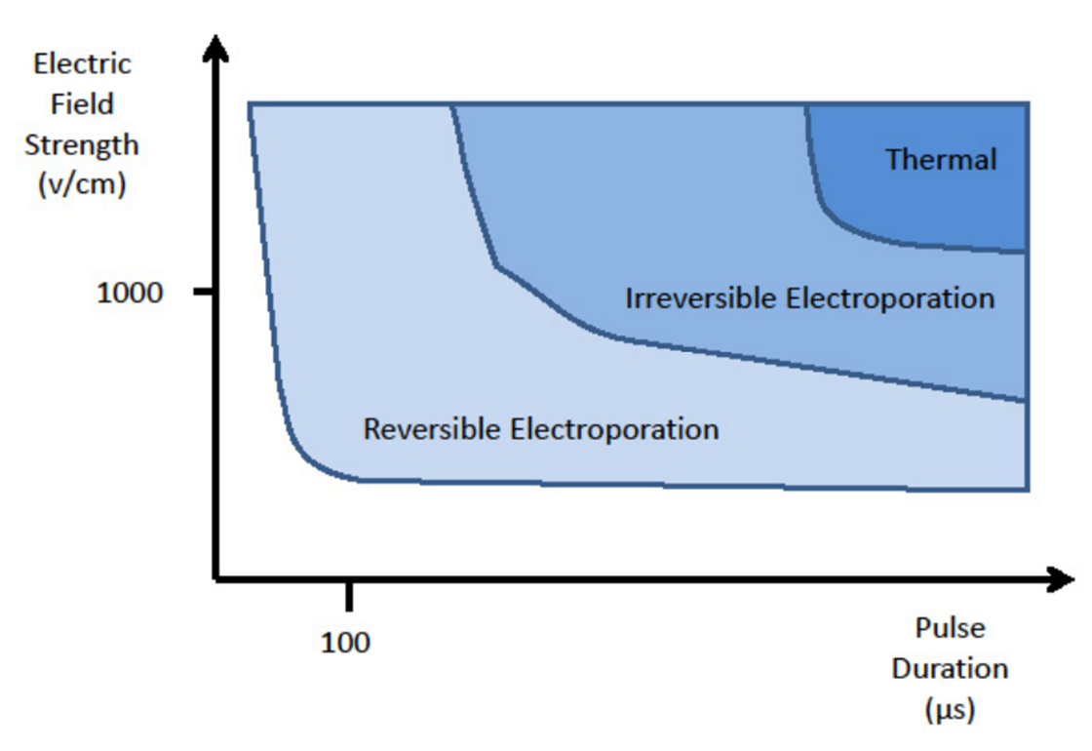
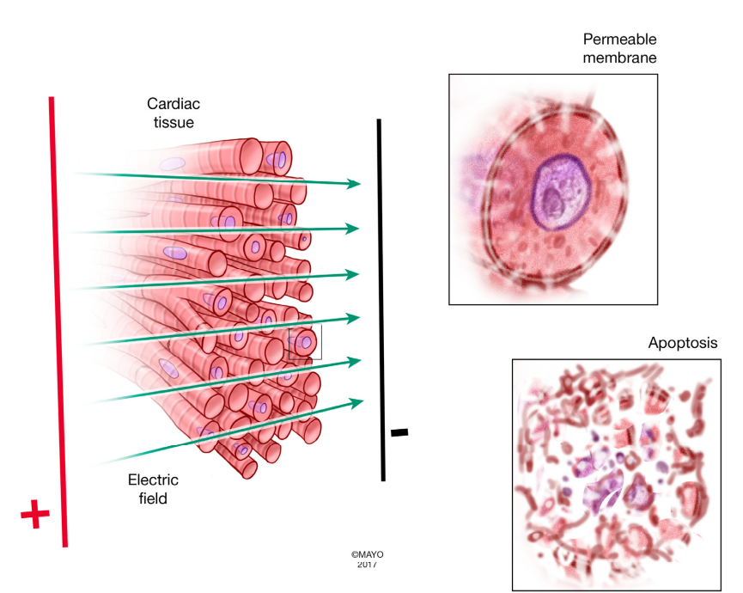
Pulsed field ablation
Electroporation is a process in which a cell membranes permeability to ions and molecules is increased when the cell is exposed to high electric fields.
- usually, in the form of short Direct Current (DC) pulses
Cell permeability ↑ attributed to the formation of nanometric pores in the cell membrane
Hence, the term “electroporation”.

Slide 15
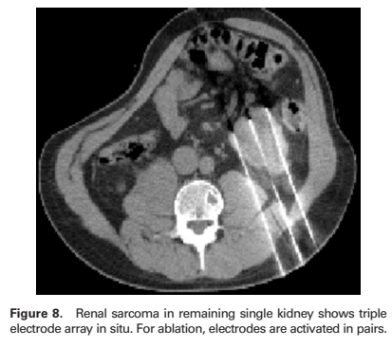
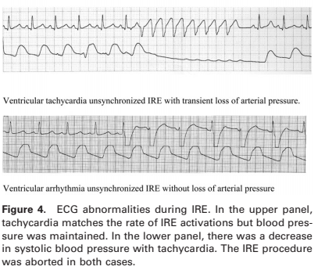
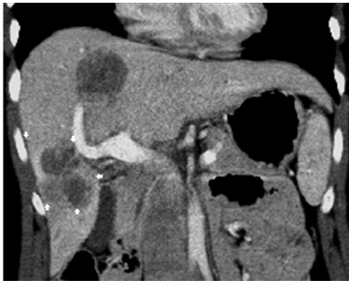
J Vasc Interv Radiol 2011; 22:611–621

Slide 16
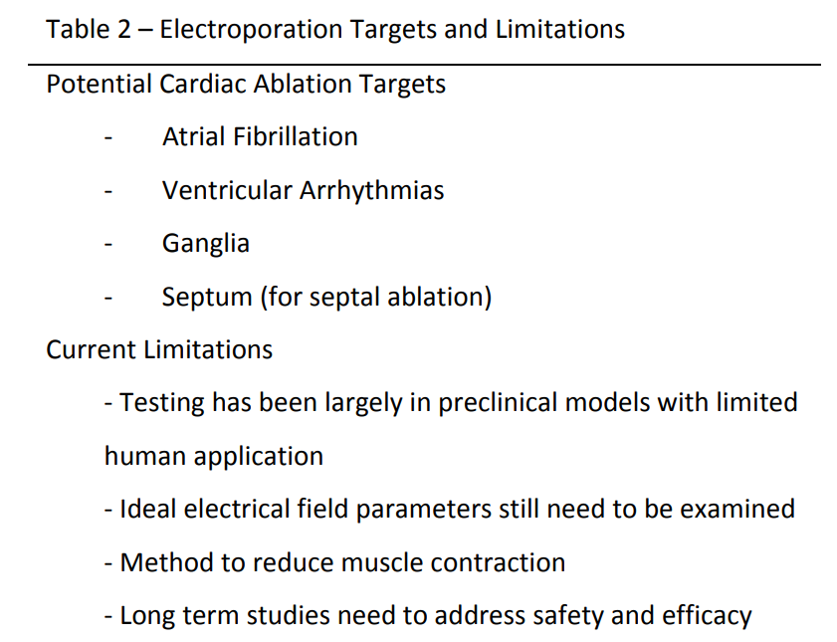
** PFA generator’s ablation waveform was limited in each patient to programmed pulse parameters
- Modifiable generator outputs ranged from
900 to 1,000 V in the monophasic cohort
1,800 to 2,000 V in the biphasic cohort
- Number of pulses varied from 4 to 10 for each application.
Expert Rev Cardiovasc Ther. 2018 May;16(5):349-360

Slide 17
Comparison of different energy sources for ablation
 | Radiofrequency | Cryothermal | Microwave | Ultrasound | Laser | Electroporation
Contact | Dependent | Dependent | Independent | Independent | Dependent | independent
Collateral damage | Yes | Yes | Yes | Yes | Yes | No
Esophagus | ++ | + | ++ | +++ | ++ | -
Phrenic nerve | ++ | ++ | ++ | ++ | ++ | -
Vagal nerve | ++ | ++ | ~ | ~ | ~ | -
Coronary A. | ++ | - | ++ | - | ++ | -
Thrombus | ++ | + | - | - | +++ | -
Tissue specificity | - | - | - | - | - | +++
Reversibility potential | - | ++ | - | - | - | +++
`
Expert Rev Cardiovasc Ther. 2018 May;16(5):349-360

Slide 18
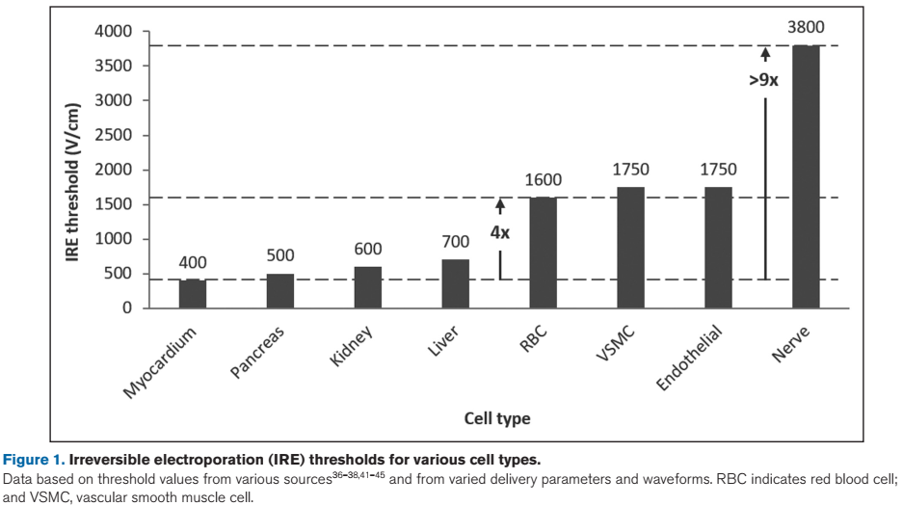
Circulation Research. 2020;127:170–183.

Slide 19
PLoS One . 2020 Feb 21;15(2):e0229214.

Slide 20
PLoS One . 2020 Feb 21;15(2):e0229214.

Slide 22
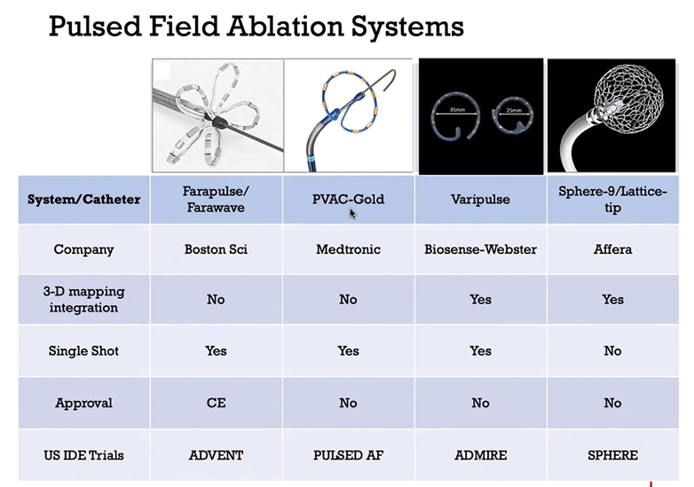

Slide 23
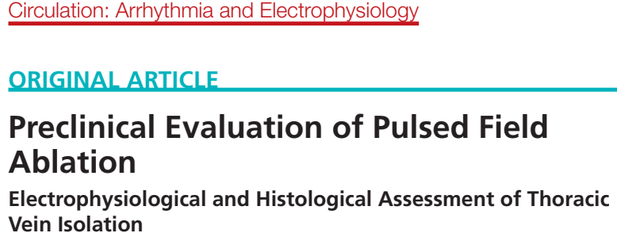
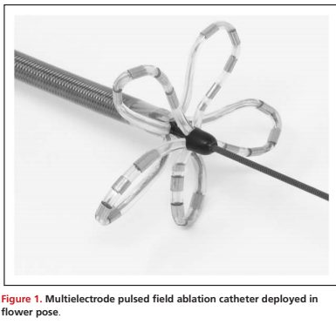
Circ Arrhythm Electrophysiol. 2019;12:e007781

Slide 24
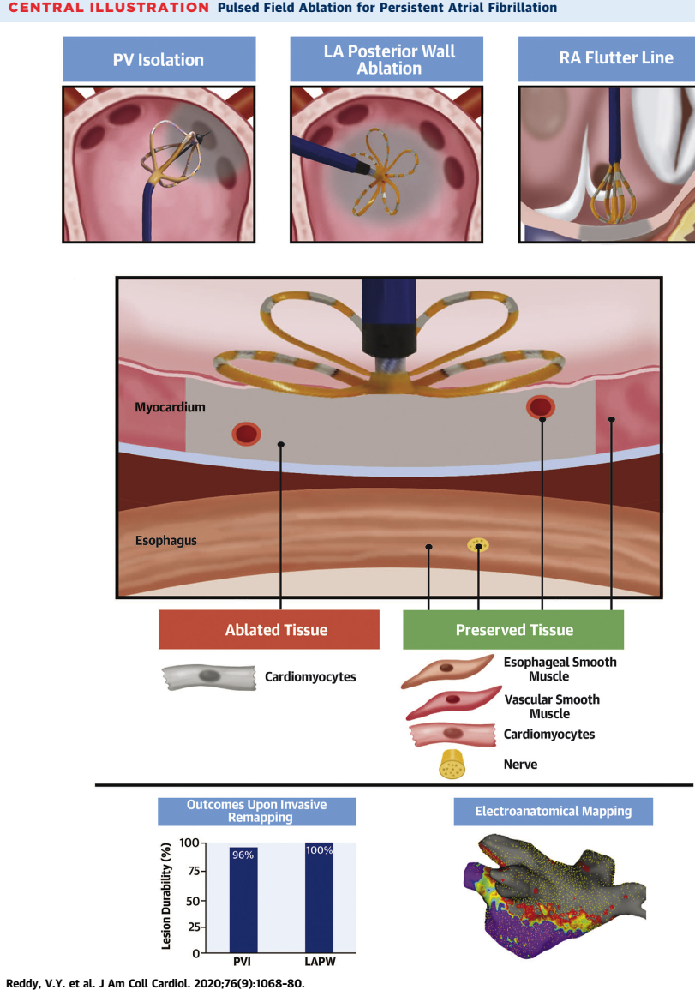
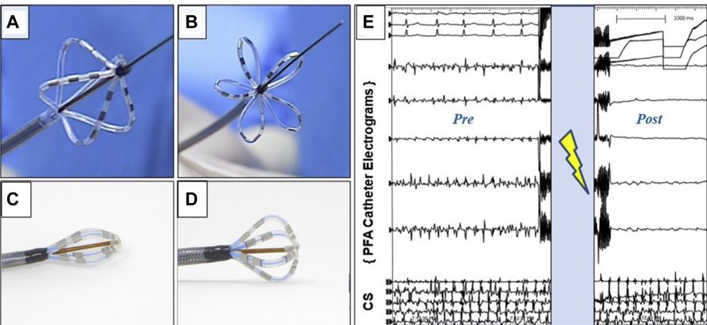
PFA using a “one-shot” catheter could safely and effectively treat patients with PerAF—including not only achieving PVI but also LAPW ablation.
The lesions were durable, setting the stage for large prospective studies of arrhythmia control
J Am Coll Cardiol . 2020 Sep 1;76(9):1068-1080

Slide 25
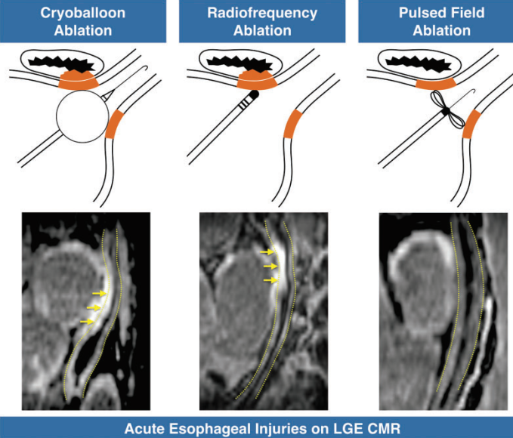
Conclusions
Pulsed electrical fields used to isolate the PVs in patients with paroxysmal AF create transmural myocardial lesions
Crucially, however, PFA does not induce any signs of esophageal injury while these are commonly observed after thermal ablation.
Europace 2021 Sep 8;23(9):1391-1399

Slide 26
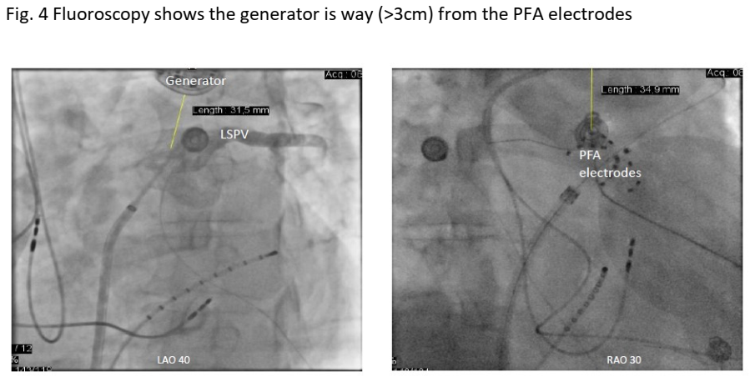
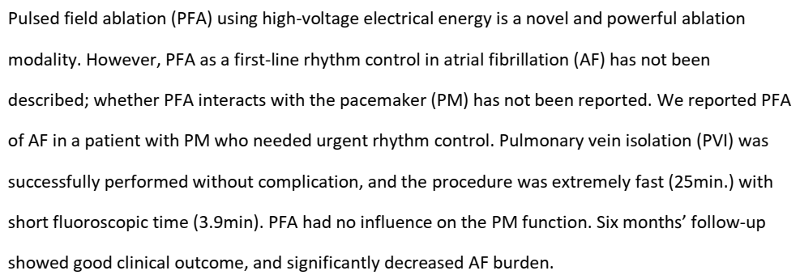
Pacing Clin Electrophysiol. 2022 Nov 24.

Slide 27
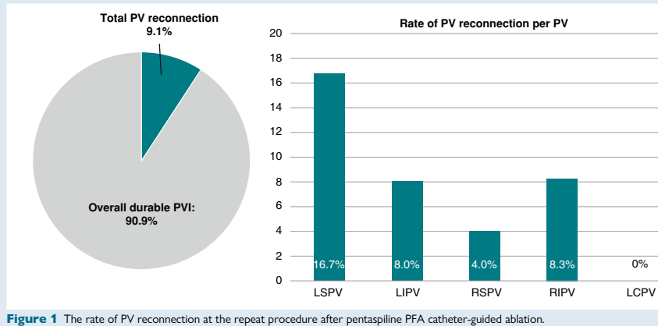
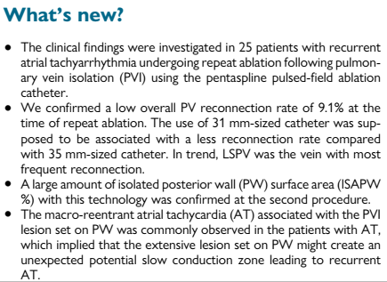
Europace. 2022 Nov 25;euac211

Slide 28
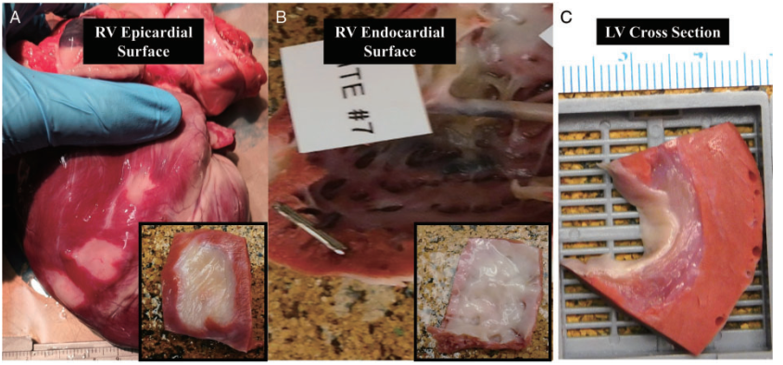
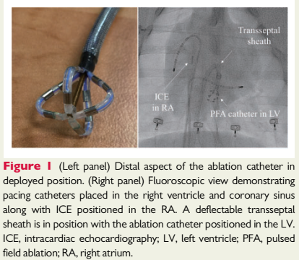
In this initial study of an exploratory dose, we demonstrate that endocardial focal PFA can be delivered using a prototype catheter.
Myocardium-specific lesions were rapidly and safely created, with dimensions that are relevant for ablation of ventricular tachycardia in the clinical setting.
Europace. 2020 Mar 1;22(3):434-439.

Slide 29
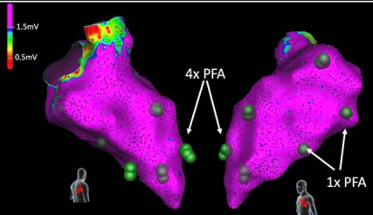
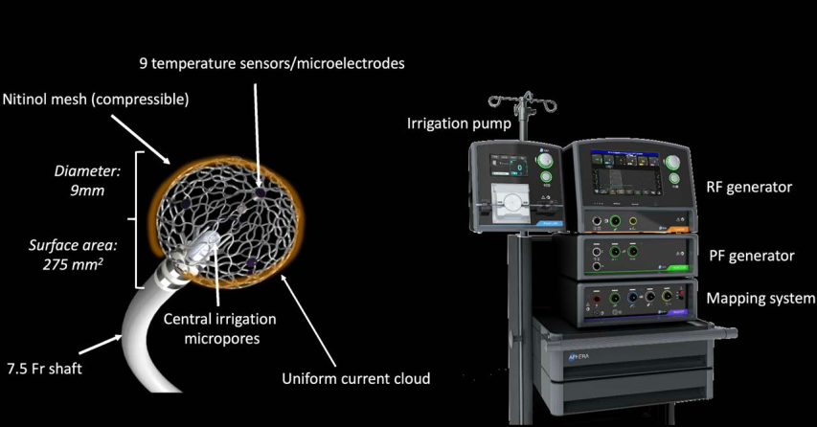
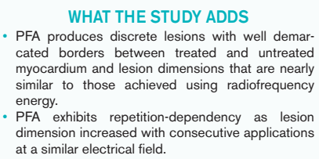
Circ Arrhythm Electrophysiol. 2021;14:e010375.

Slide 30
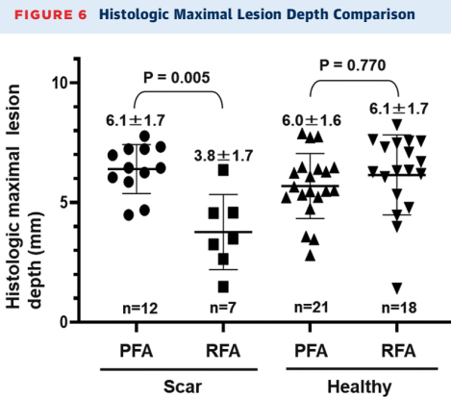
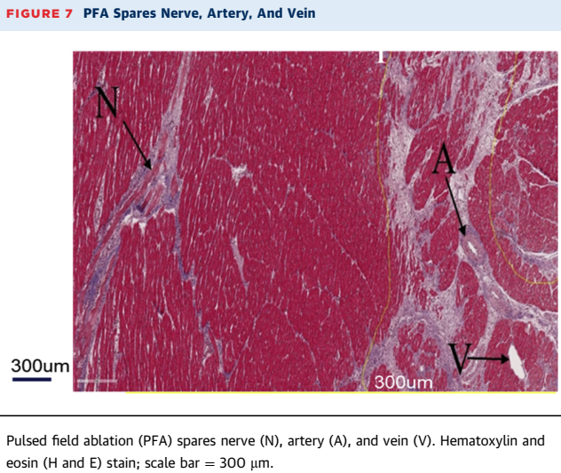
Conclusions PFA allows rapid, safe, and effective ablation of surviving islands of myocardium within and around infarcted LV substrate. This technology holds promise for treating infarct-related VT in humans

Slide 31
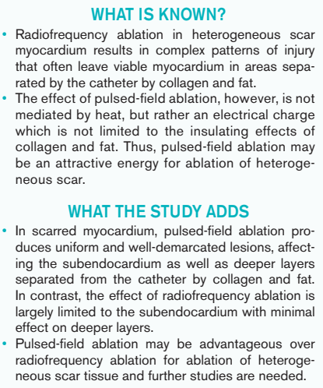
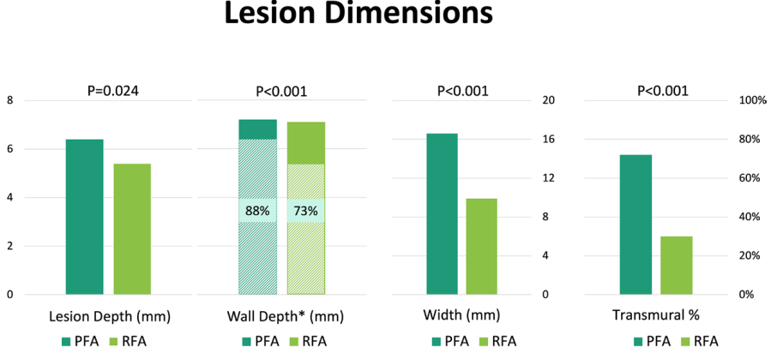
Figure 3. Comparison of lesion dimensions at infarct border zone
Circ Arrhythm Electrophysiol. 2022;15:e011209.

Slide 32
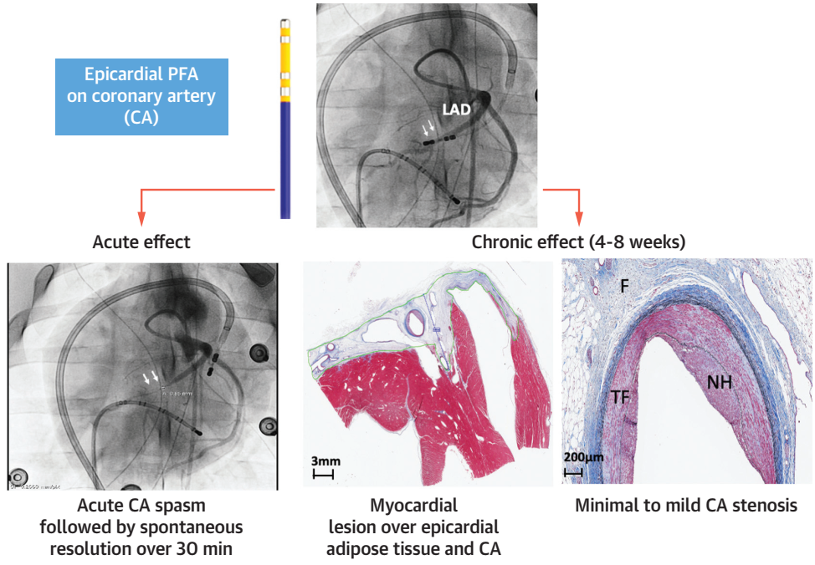
Conclusions In a swine model, epicardial PFA directly on CAs allowed the creation of myocardial lesions but led to a CA response characterized by acute moderate spasm and chronic mild stenosis via neointimal hyperplasia.
J Am Coll Cardiol EP. Oct 26, 2022.

Slide 33
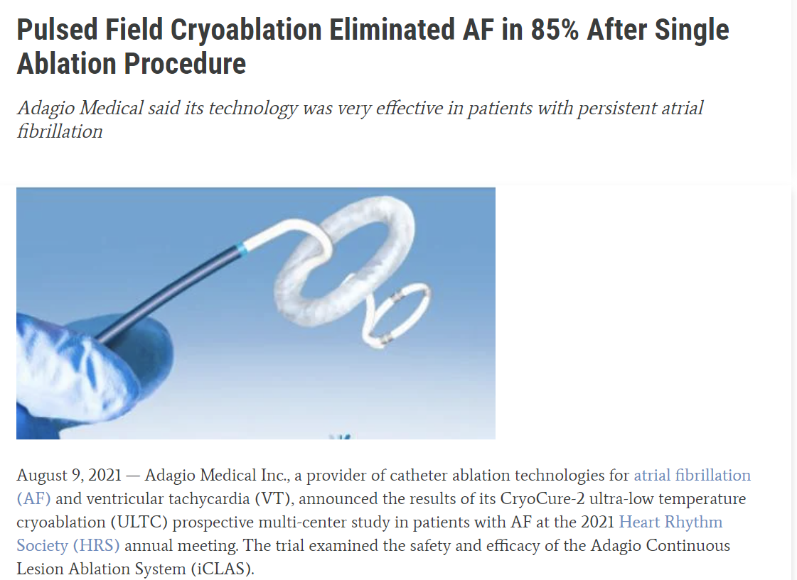

Slide 34
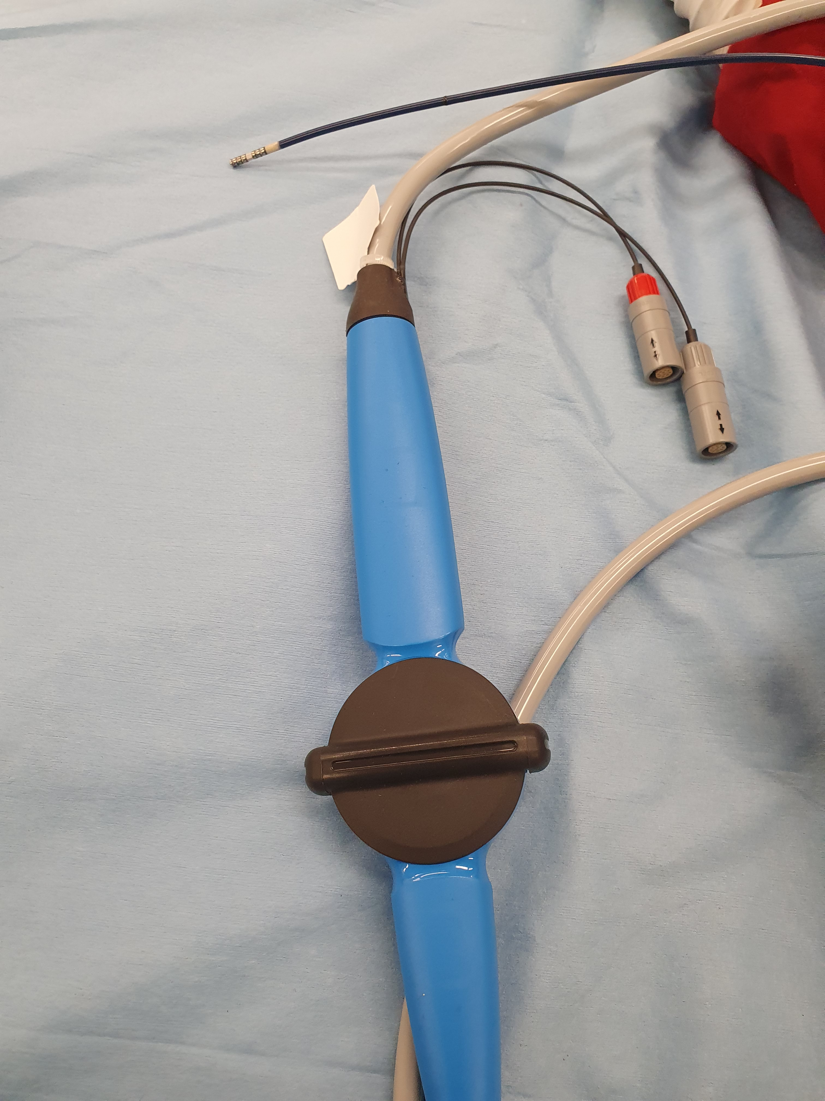
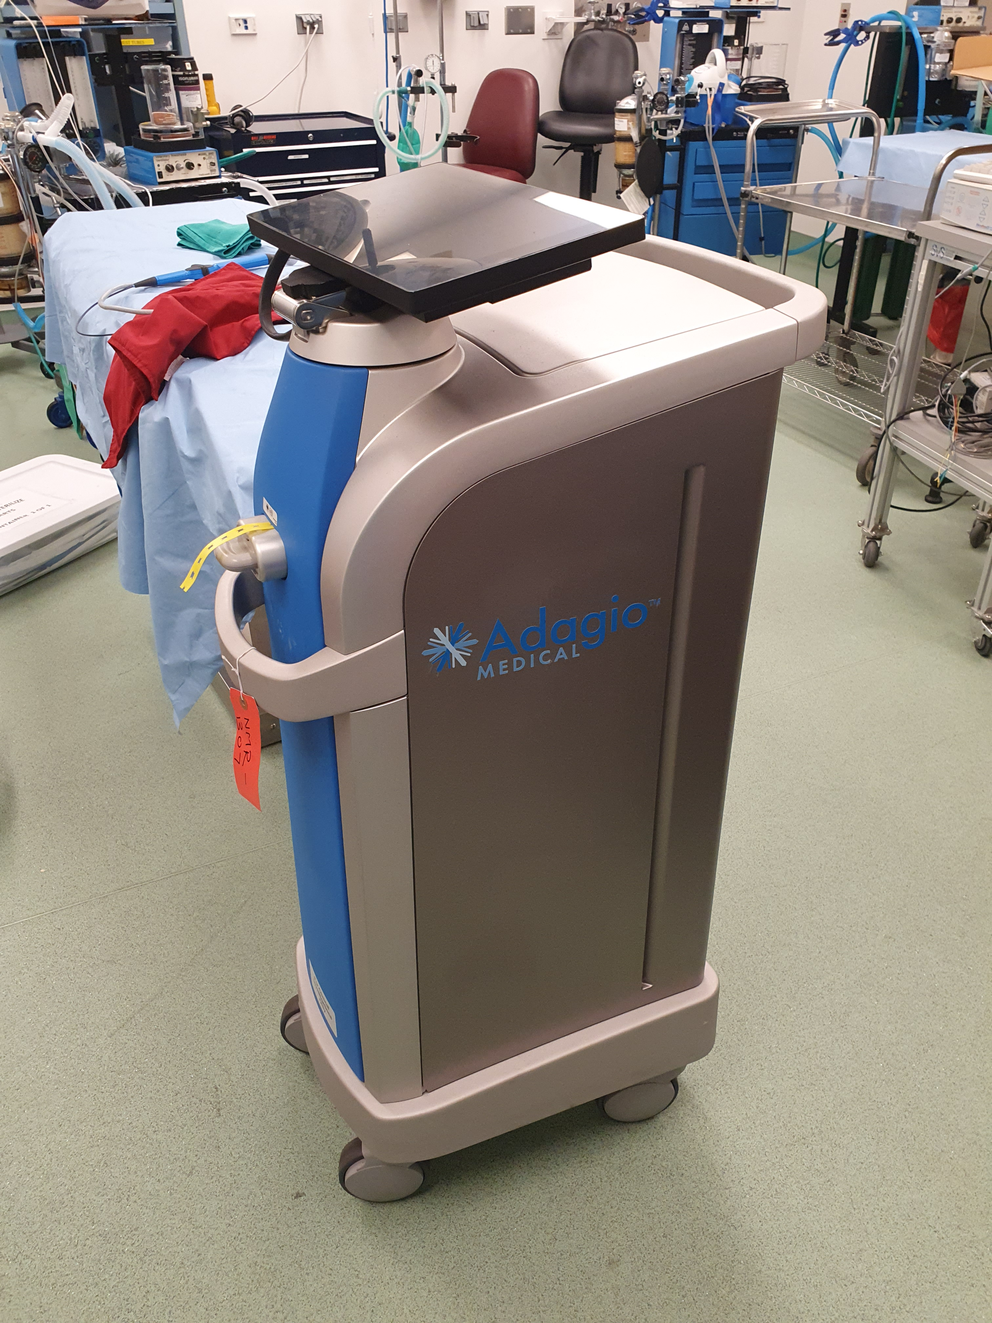
Pulsed field cryoablation - new version Adagio catheter

Slide 35
Limitations in several studies of PFA
Preclinical swine/ animal studies
Small sample size
Catheters/electroporation waveform optimized for atrial ablation
Limited data about long term follow-up to address safety and efficacy

Slide 36
Summary (PFA)
PFA of viable myocardium in and around infarcted substrate is feasible
Viable myocardium both within and epicardial to the infarct was successfully ablated
PFA waveforms quickly and safely produced lesion depths
Notes:
To summarize
PFA waveforms quickly so 10 seconds total ablation time and safely produced lesion depths up to 7.3mm.

Slide 37
 | RFA | PFA
장점 | 익숙하다 | 빠르다
 | 다양한 임상경험으로 예후를 예측할 수 있다. | Scar area에도 쉽게 ablation된다
 |  | N/A/V collateral damage가 적다
 |  | Contact이 꼭 필요하지 않을 수 있다.
단점 | 오래 걸린다. | Long term outcome에 대한 결과가 없다.
 | Scar area에 ablation이 쉽지 않다 | 경험이 부족하다
 | N/A/V collateral damage가 있을 수 있다 | Optimal wave form과 voltage가 아직 명확히 않다.
 | Contact 이 중요하다
 | Adipose tissue, collagen등 장애물이 있을 경우 ablation어렵다

Slide 38
Conclusion
PFA may be advantageous for ablation in ventricular scar, producing lesions that unlike RFA are not limited to the sub-endocardium.
also eliminate viable myocardium separated from the catheter by collagen and fat.

